Slide 1
Group 1
Air BnB

Slide 2
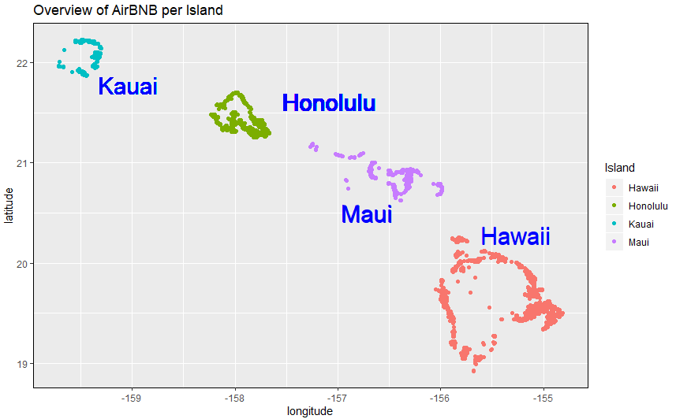
Overview of AIRBnb by Island

Slide 3
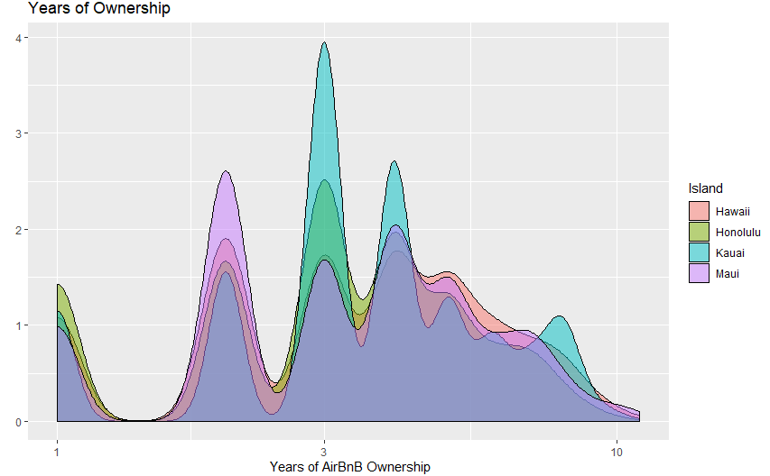
Years of Ownership

